Slide 1
Home Automation using Hand Gestures
Professor – Ali Zaringhalam
Members:
Amit Bhorania Prasad Patil
Ashutosh Gajankush Shivangi Rai
Chiranth HD Sumanth Darisi

Slide 2
Contents
Project Demo
Introduction
Hardware Details
Software Details
Project Outcome
Limitations & Future Enhancement

Slide 3
Introduction
Project deals with Hand gesture recognition for home automation
User friendly gestures to operate Device On/Off
Accelerometer sensor wristband which senses the acceleration of hand movement
Raspberry Pi process the sensor data with Machine Learning Algorithm
Operate the devices as per the detected Hand Gestures

Slide 4
Application
People with Mobility Challenges
Home Automation
Operating Devices for example – TV (Power On/Off, Channel next/prev, Volume Up/Down)
Gesture based Gaming
Wheel Chair Control

Slide 5
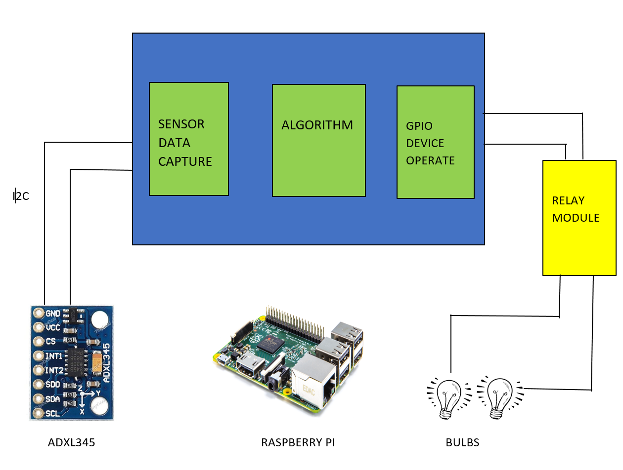
System Block

Slide 6
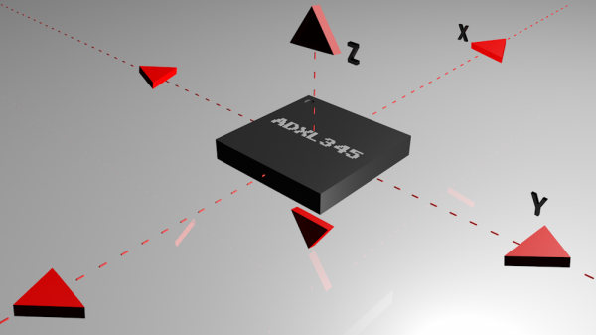
Accelerometer
Accelerometer measures the acceleration (rate of change of velocity) in X, Y and Z axis
Unit is m/s² or in terms of g (9.8 m/s²)
ADXL345 Accelerometer Sensor
Low power, High resolution (10 bit) with +/- 2g range
Interfaces on I2C Interface for data communication

Slide 7
Raspberry Pi
Credit Card sized computer
Low Cost
Raspbian or Linux OS
Specification
  1GB RAM
  Micro SD Storage
  HDMI Port, 4 USB Ports
  26 GPIOs available
  Supports different interfaces like UART, I2C, SPI etc.
Python supports
Lots of Libraries, Documentation and Community available

Slide 8
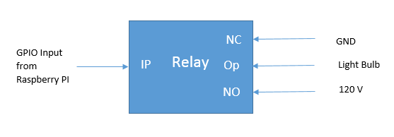
Relay Module
2 Channel 5V SPDT Relay
Handles the AC Devices with the input from Digital Devices
Normally Close (NC) – GND
Normally Open (NO) – 120 V
Raspberry Pi provides input using its GPIO pins
On input High, Op will be connected to NO pin internally

Slide 9
Sensor Interfacing
Raspberry Pi is connected with ADXL345 Sensor on I2C
I2C – 2 wire Serial Protocol popular in Microcontroller communication
Initialize the I2C Interface
Read the Sensor value of 3 Axis using the I2C Protocol
(Start Bit, Address, Read/Write, Register Address, ACK, Stop Bit)

Slide 10
Machine Learning Algo
Heart of the Project
Process the Accelerometer Sensor Data using custom Machine Learning Algo
Algorithm detects the Hand Gesture
GPIO Module operate the Devices as per the detected hand gesture

Slide 11
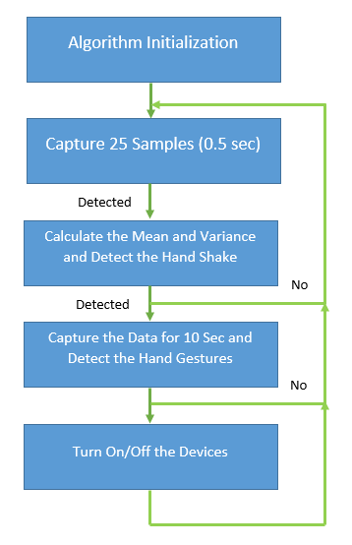
Algorithm

Slide 12

Teaser Project Demo…

Slide 13
Challenges
Controlling the PI using the Laptop without HDMI Display
Deciding the Algorithm
Calibrating the Sensors
Gesture Tuning

Slide 14
Contribution
Amit Bhorania
  Loading the Raspbian OS and config the Pi to control from Laptop
  Searching for Machine Learning Algorithm by going through various Research Papers
Ashutosh Gajankush
  Understanding & Interfacing the Accelerometer Sensor with PI
Prasad Patil & Shivangi Rai
  Ordering & Soldering the components, Taking the Gesture Samples
  Interfacing the Relay module with GPIO
Chiranth HD and Sumanth Darisi
  Implementing the Machine Learning Algorithm

Slide 15
Result
Using the Raspberry Pi, Accelerometer Sensor and Machine Learning Algorithm, We operated the Home Appliances using Hand Gestures

Slide 16
Limitation
User needs to wear the Accelerometer wrist band
Current design is using the wired communication between Sensor and Raspberry PI but we can make it wireless

Slide 17
Future Enhancement
Wireless interface between Sensor and Raspberry Pi using ESP8266 Wifi Module
Interface the Algorithm with other Devices like Projector or TV
Add more Gestures to the Algorithm to handle multiple devices

Slide 18
Questions…

Slide 19
Thank you

